Slide 1

Sprinkle Routes
Travel Guide: Dream Journeys, beyond boundaries
Presented by:
Byte Hogs

Slide 2
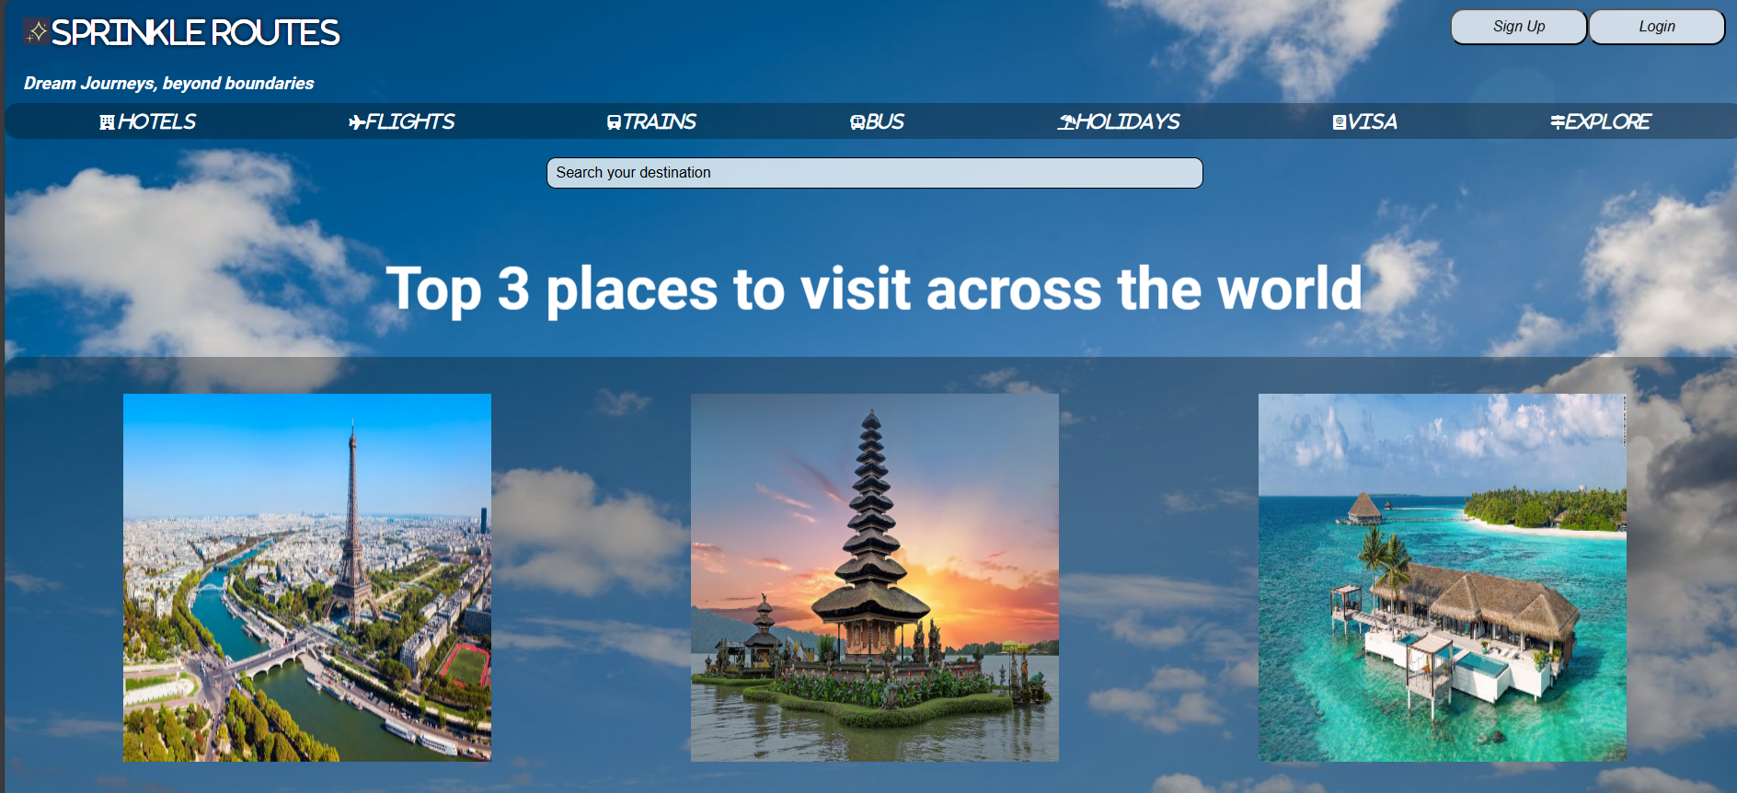
Sprinkle Route’s UI is all about making it easy and enjoyable for users. In this presentation, we’ll dive into its cool design features and how it creates a great user experience.
Introduction to Sprinkle's UI

Slide 3
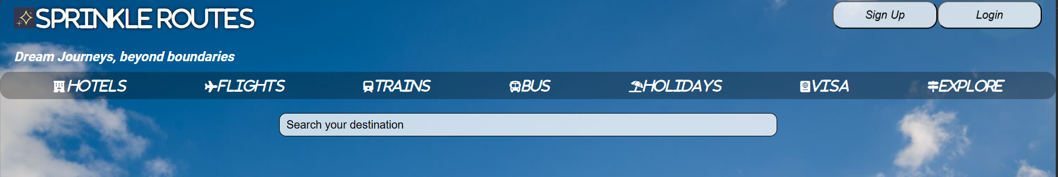
Effective navigation is essential for a positive user experience. Sprinkle features an intuitive navigation menu that allows users to find content quickly.
Navigation Experience

Slide 4
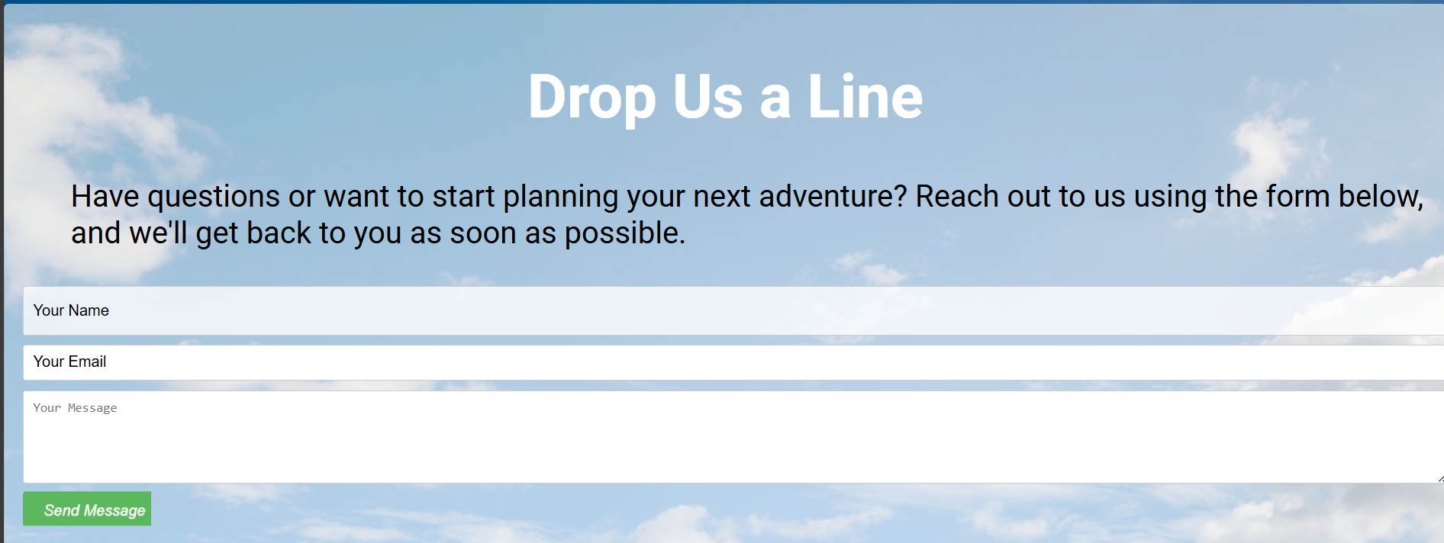

Slide 5
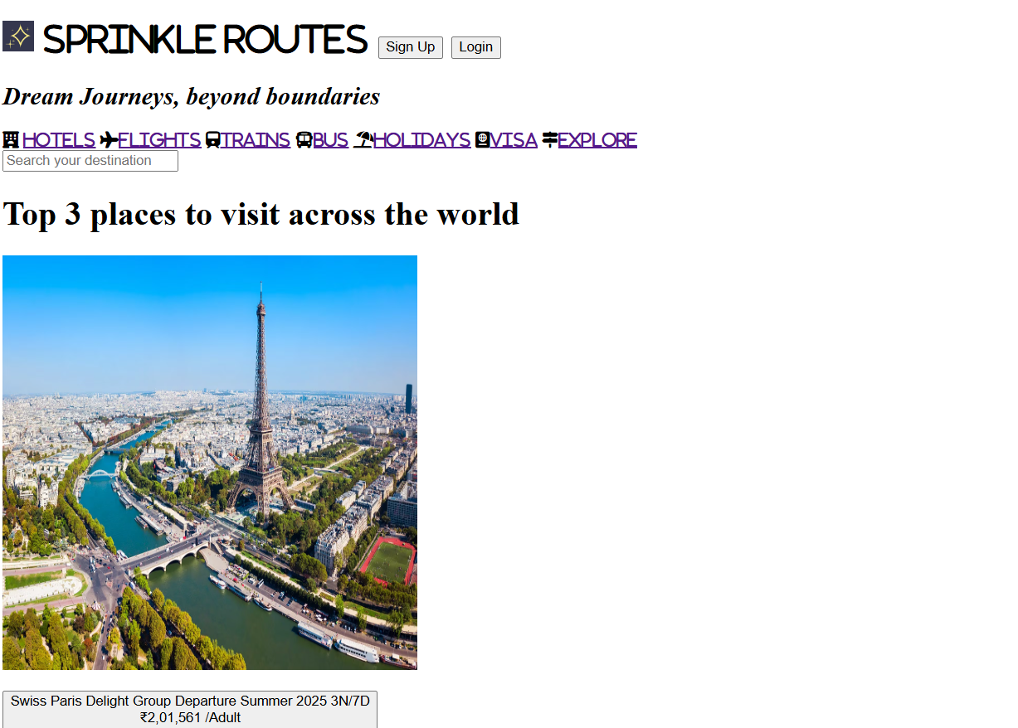
Key Html elements in webpage
Header (<header>tag): Introduces the website with a title and subtitle
Navigation (<nav> tag): Contains menu links for easy navigation.
Search Bar (<input> tag): Allows users to search for destinations.
Images and Buttons (<img> and <button> tags): Display visual content and provide interactive elements for travel packages.
Before applying CSS elements

Slide 6

Global CSS styling
1. Global and Header Styling: Sets font, background, and text styles .
2. Navigation and Search Bar: create a responsive navigation bar with consistent styling for icons and links, while customizing the search bar's appearance.
3. Button and Animation Effects: Provides styles for buttons with hover effects and animations, giving a "pop" and "wave" movement to elements for interactivity.
4. Image and Layout Formatting: Used for layout consistency across sections like travel packages, destinations, and rows, with margins and border-radius adjustments for images.
5. Container Styles: Adds styles for contact forms and container elements, ensuring background colors, padding, and border-radius create a cohesive design throughout the page.
After adding the CSS to the html structure

Slide 7

Thank You
This is our website:
https://sahasra1209.github.io/sprinkle/

